Slide 1

Drama At Cornwallis Academy
Year 8 – LESSON 1
Lesson Objective:
-Demonstrate an understanding of how to show a character
-Recap on the importance to use facial expression and gestures when developing a character (Reflecting on the work from year 7).
-To follow instructions in order to take part in a Murder Mystery
Success Criteria:
Performing and Creating
Level 3
I can sustain a role that I have created for some of the performance. I am more comfortable being led by others in a group situation.
Level 4
I can stay in role for good parts of my performance, occasionally struggling to keep focused. I will make a reasonable contribution to my groups work, sharing some simple ideas.
Level 5
I can stay in role for most of the performance with few distractions. I will make a positive contribution to a group, sharing ideas and showing some leadership.
Level 6
I can consistently stay in role for the whole of the performance. I Contribute ideas very well to the group I’m in and am capable of showing good leadership skills
Notes:
You will need to use this lesson to assessment students current ability. You will need to do a baseline assessment.

Slide 2
Lesson Objective:
-Demonstrate an understanding of how to show a character
-Recap on the importance to use facial expression and gestures when developing a character (Reflecting on the work from year 7).
-To follow instructions in order to take part in a Murder Mystery
Re-cap of RULES AND EXPECTATIONS
- Always line up in silence outside the room.
Enter the room quietly, stand in a circle in silence until instructed to sit on the floor in a circle.
NO chewing or eating
NEVER touch any props or classroom equipment without permission.
Support and encourage others
WILF:
Creating and Performing
Level 3
I can sustain a role that I have created for some of the performance. I am more comfortable being led by others in a group situation.
Level 4
I can stay in role for good parts of my performance, occasionally struggling to keep focused. I will make a reasonable contribution to my groups work, sharing some simple ideas.
Level 5
I can stay in role for most of the performance with few distractions. I will make a positive contribution to a group, sharing ideas and showing some leadership.
Level 6
I can consistently stay in role for the whole of the performance. I Contribute ideas very well to the group I’m in and am capable of showing good leadership skills

Slide 3
Lesson Objective:
-Demonstrate an understanding of how to show a character
-Recap on the importance to use facial expression and gestures when developing a character (Reflecting on the work from year 7).
-To follow instructions in order to take part in a Murder Mystery
Introduction to Murder Mystery unit
Starter Discussion:
-This term is going to be all about Murder Mystery and will result in you creating a final performance of your own that you will devised.
Murder Mystery cool riddle – Murder Mystery game 1
YouTube video clip:
Who is the Murderer? (Achievement points available)
What do we mean by the word devise?
Success Criteria:
Creating and Performing
Level 3
I can sustain a role that I have created for some of the performance. I am more comfortable being led by others in a group situation.
Level 4
I can stay in role for good parts of my performance, occasionally struggling to keep focused. I will make a reasonable contribution to my groups work, sharing some simple ideas.
Level 5
I can stay in role for most of the performance with few distractions. I will make a positive contribution to a group, sharing ideas and showing some leadership.
Level 6
I can consistently stay in role for the whole of the performance. I Contribute ideas very well to the group I’m in and am capable of showing good leadership skills

Slide 4
Lesson Objective:
-Demonstrate an understanding of how to show a character
-Recap on the importance to use facial expression and gestures when developing a character (Reflecting on the work from year 7).
-To follow instructions in order to take part in a Murder Mystery
Warm-up
Showing different emotion:
You will need to walk around the room and act out the different emotions as they are called out. However you will need to demonstrate the emotions at different levels. For example; anger: level 1= very mildly annoyed, level 10= furious.
Success Criteria:
Creating and Performing
Level 3
I can sustain a role that I have created for some of the performance. I am more comfortable being led by others in a group situation.
Level 4
I can stay in role for good parts of my performance, occasionally struggling to keep focused. I will make a reasonable contribution to my groups work, sharing some simple ideas.
Level 5
I can stay in role for most of the performance with few distractions. I will make a positive contribution to a group, sharing ideas and showing some leadership.
Level 6
I can consistently stay in role for the whole of the performance. I Contribute ideas very well to the group I’m in and am capable of showing good leadership skills
Notes:
After the task get students sad on the floor in order to await further instructions.

Slide 5
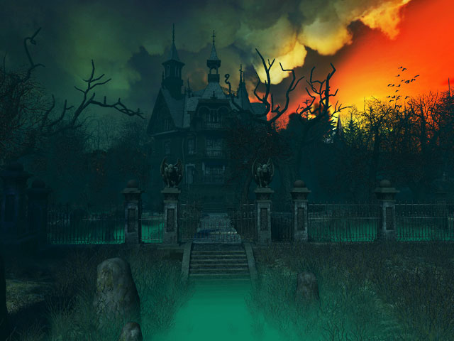
Mystery Manor House
Notes:
Play some spooky music to add dramatic effect. Student swill now take part in a Murder Mystery led by you.

Slide 6
My Name is Mrs. Harvey. I have recently inherited a Manor House and want to sell it. However there have been rumours that the house is haunted no one is interested in buying it. I will offer 100 pounds to anyone who will spend one night in the Manor House to prove that it is not haunted.
Mystery Manor House
Notes:
This is the introduction and sets the scene. As a class over the next two lessons you will set up the murder mystery and they will all imagine that they are going to spend the night there.

Slide 7

Mystery Manor House
TASK
After the departure of Mrs. Harvey you need to work on developing a character that you will be playing for the next 2 weeks. You will need to decide on the following:
-Your name, Age and Occupation
-Why you are interested in the offer of 100 pounds?(you might need the money, you are curious, have an interest in haunted houses)
-Who you are with.
Working in a pair you will have 10 minutes to each log your decisions on your piece of paper. This unit of work is all about using your imagination so try to be as creative as possible.

Slide 8
Mystery Manor House
TASK
(2) What decisions did you make?
We will now have a class discussion about all the ideas that you have come up with.
10 minutes
Notes:
In pairs get the students to stand up and reveal the decisions they have made about their characters.

Slide 9
Mystery Manor House
TASK
(3) In one minute you will need to line up either inside or outside the room in silence.
(4) You have now arrived at the manor house. When you enter the room you will need to mime your entrance into the house. You will need to concentrate on body language, facial expressions and what might be going on around you. For example any smells. How might you feels etc…? 10 minutes
Notes:
(3) If you can line students up in silence outside and get them to enter the room as if they are entering the manor house it would be useful. If not line them up against one wall. They will then need to enter the room as if they have arrived at the manor house.

Slide 10
Mystery Manor House
TASK
(5) In groups you will now need to discuss your situation-Where are you going to sleep? Why is Mrs Harvey not there? How are you going to deal with no electricity?
Log your decisions on your given piece of paper.
10 minutes

Slide 11
Mystery Manor House
TASK
(6) One group at a time you will now act out your decisions. Remember to think about the emotions your characters might be feeling and how you will show these. To achieve the higher grades you need to think about your use of voice and accent and developing a clear character.
15 minutes
Notes:
During this task you will need to grade students on their current ability.

Slide 12
Lesson Objective:
-Demonstrate an understanding of how to show a character
-Recap on the importance to use facial expression and gestures when developing a character (Reflecting on the work from year 7).
-To follow instructions in order to take part in a Murder Mystery
FEEDBACK
Question and Answer exercise
1) What have you learnt from playing a character?
2) What did you find easy or hard about playing a character?
3) What are your initial thoughts about the Murder Mystery?
4) How do you think the story might develop next week?
5) What do you feel you need to work on to improve your character for next week’s lesson?
Success Criteria:
Creating and Performing
Level 3
I can sustain a role that I have created for some of the performance. I am more comfortable being led by others in a group situation.
Level 4
I can stay in role for good parts of my performance, occasionally struggling to keep focused. I will make a reasonable contribution to my groups work, sharing some simple ideas.
Level 5
I can stay in role for most of the performance with few distractions. I will make a positive contribution to a group, sharing ideas and showing some leadership.
Level 6
I can consistently stay in role for the whole of the performance. I Contribute ideas very well to the group I’m in and am capable of showing good leadership skills
Notes:
Group discussion

